Slide 1
Carisbrook Flood levees
Community Consultation
Paul Southcott – 1 March 2021

Slide 2
Outline of Presentation
    History of project
    Sources of flooding
    Options considered
    Design of levees.

Slide 3
History of project
    Carisbrook impacted by flooding 2010 and 2011
    Water Technology study completed 2013
    Entura completed preliminary design and detailed design in 2016
    Water Technology study updated 2019
    Entura made minor modifications to design 2020

Slide 4
Sources of flooding
    Flooding in Carisbrook from 3 sources:
    Tullaroop and McCallum Creeks
    From the west of the town
    To a lesser extent from the Williams road area

Slide 5
Flood Extents no protection

Slide 6
Flood mitigation
    Flood mitigation in Carisbrook by:
    Vegetation clearing in Tullaroop and McCallum Creeks
    Flood levee to west of the town
    Flood levee in Williams road area
    A non-return valve on culverts under Landrigan Road near Camp Street
    The highway bridge be replaced with a clear-span structure when the bridge is due for replacement in the long term

Slide 7
Preliminary Design:
Option A - preferred

Slide 8
Preliminary Design:
Option B

Slide 9
Design arrangement

Slide 10
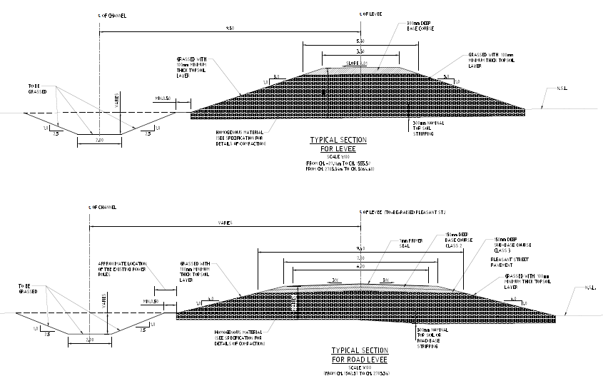
Design section
Channel to carry small floods
1% AEP Flood Level

Slide 11
outcome

Slide 12
END

